Slide 1
Project Scope Management
By
Humaira Afzal
Lecturer CS, CUI Lahore Campus

Slide 2
Project Scope Management
Project Scope Management includes the processes required to ensure that the project includes all the work required, and only the work required, to complete the project successfully.

Slide 3
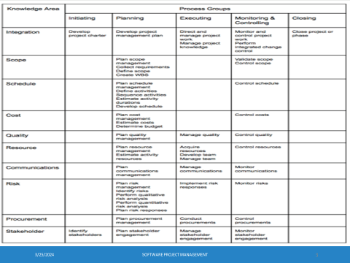

Slide 4
Project Scope Management Processes
The Project Scope Management processes are:
1. Plan Scope Management: The process of creating a scope management plan that documents how the project and product scope will be deﬁned, validated, and controlled.
2.Collect Requirements: The process of determining, documenting, and managing stakeholder needs and requirements to meet project objectives.
3.Define Scope: The process of developing a detailed description of the project and product.
4.Create WBS: The process of subdividing project deliverables and project work into smaller, more manageable components.

Slide 5
Project Scope Management Processes
5.Validate Scope: The process of formalizing acceptance of the completed project deliverables. Validate scope process checks whether a deliverable meets its agreed requirements against the approved scope. That is used to formally accept completed project deliverables.
6. Control Scope: The process of monitoring the status of the project and product scope and managing changes to the scope baseline.
KEY CONCEPTS FOR PROJECT SCOPE MANAGEMENT
In the project context, the term “scope” can refer to:
Product scope. The features and functions that characterize a product, service, or result.
Project scope. The work performed to deliver a product, service, or result with specific features and functions.

Slide 6
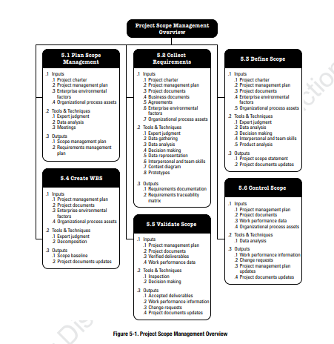

Slide 7
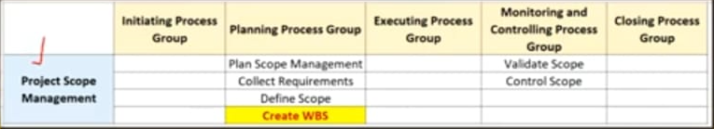
CREATE WBS
Create WBS is the process of subdividing project deliverables and project work into smaller, more manageable components.
key beneﬁt:
It provides a framework for what has to be delivered.

Slide 8
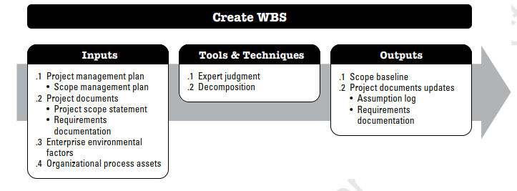

Slide 9
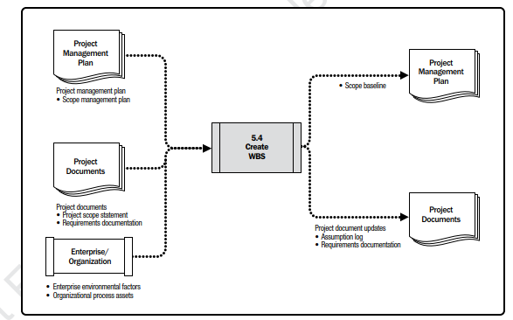

Slide 10
CREATE WBS: INPUTS
1 PROJECT MANAGEMENT PLAN
A project management plan component includes a scope management plan. The scope management plan documents how the WBS will be created from the project scope statement.
2 PROJECT DOCUMENTS
Project scope statement. The project scope statement describes the work that will be performed and the work that is excluded.
Requirements documentation. Detailed requirements describe how individual requirements meet the business needs of the project.
3 Enterprise Environmental Factors: Industry-speciﬁc WBS standards
4 Organizational Process Assets: Policies, procedures, and templates for the WBS, Lessons learned from previous projects.

Slide 11
CREATE WBS: TOOLS AND TECHNIQUES
Decomposition: Decomposition is a technique used for dividing and subdividing the project scope and project deliverables into smaller, more manageable parts.
Decomposition of the total project work into work packages generally involves the following activities.
Define Project Scope: Define the project boundaries. what is included and excluded?
Identify Major Deliverables: List all the significant outcomes or products that the project will produce.
Break Down Major Deliverables: For each major deliverable, break them down into smaller, more manageable tasks or sub-deliverables. Use a hierarchical structure to organize these components.

Slide 12
CREATE WBS: TOOLS AND TECHNIQUES
Keep Breaking Down: Continue breaking down each sub-deliverable into smaller tasks until you reach a level where the tasks are easily manageable and can be assigned to a specific team member.
Use a Hierarchical Structure: Hierarchically organize the tasks, starting with the top-level major deliverables and drilling down to the smallest tasks.
Assign Codes and Identifiers: Assign unique codes or identifiers to each element in the WBS to facilitate tracking and referencing.
Review and Validate: Review the WBS with key stakeholders to ensure that all necessary tasks are included and that there is a common understanding of the project's structure.
Validate the WBS against the project scope to ensure alignment with project objectives.

Slide 13
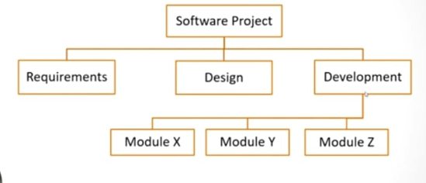
CREATE WBS
Work Package is a specific piece of work. You create a work package when you break a deliverable into separate components during the creation of WBS. We can view work packages as “mini-projects” for which cost and duration can be estimated and managed.
Work Package Example:

Slide 14
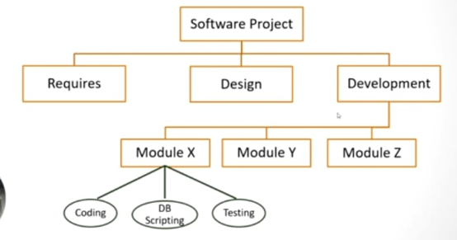
CREATE WBS
Activity: A distinct, Scheduled portion of work performed during the course of the project.
Activity Example:

Slide 15
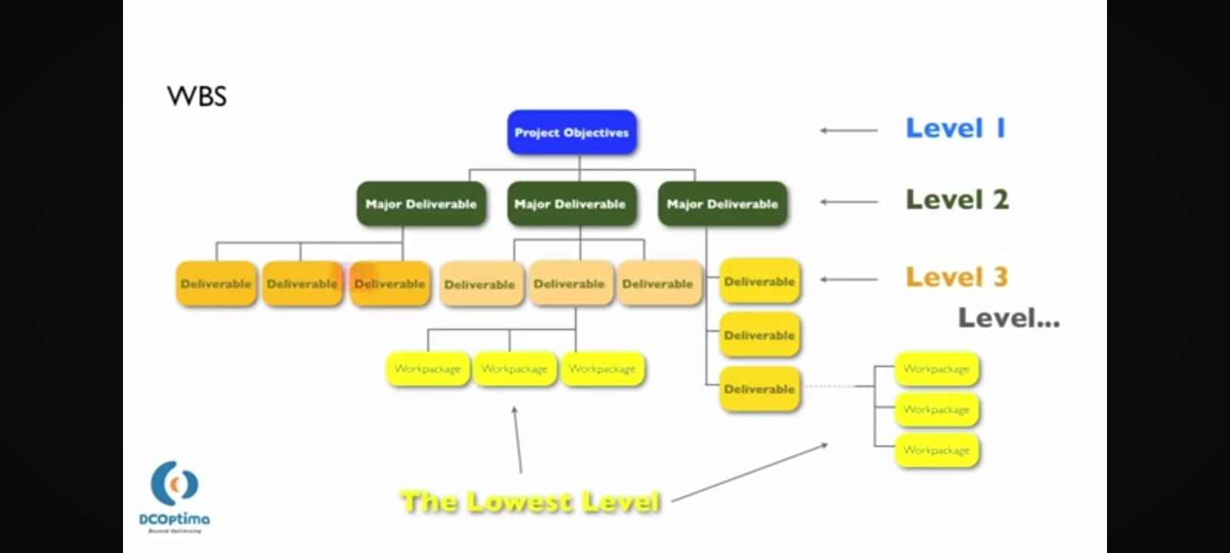

Slide 16
CREATE WBS
A WBS structure may be created through various approaches. Some of the popular methods include the top-down approach, the use of organization-speciﬁc guidelines, and the use of WBS templates. A bottom-up approach can be used to group subcomponents. The WBS structure can be represented in several forms, such as:
Using phases of the project life cycle as the second level of decomposition, with the product and project deliverables inserted at the third level…Phase Oriented
Using major deliverables as the second level of decomposition…Deliverables Oriented.
Deliverable-oriented work breakdown structures list all the smaller products of work that, put together, comprise the final product.

Slide 17
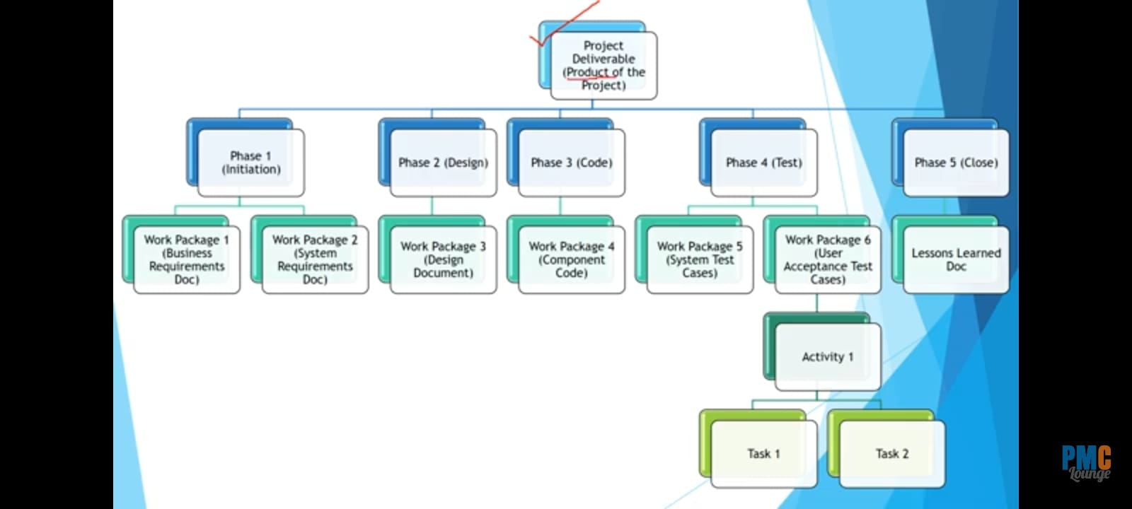

Slide 18
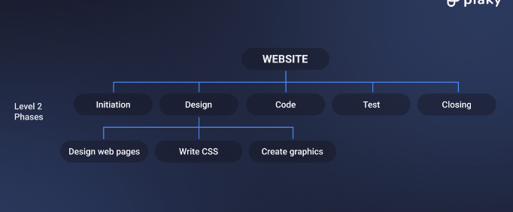
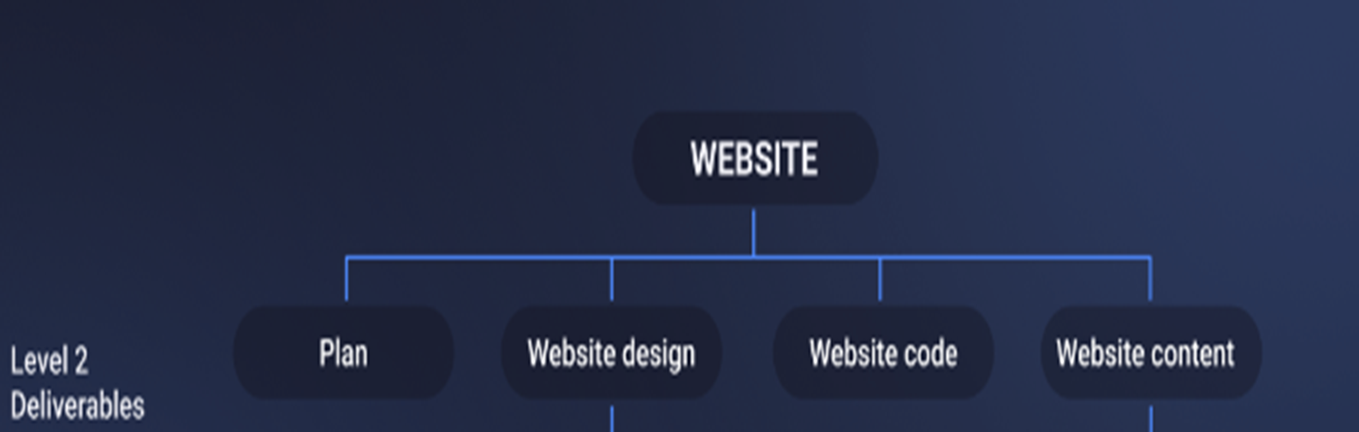

Slide 19
CREATE WBS: OUTPUTS
1 SCOPE BASELINE: Components of the scope baseline include:
Scope baseline = Project Scope Statement +Work Break Down Structure + WBS Dictionary
Project scope statement. The project scope statement includes the description of the project scope, major deliverables, assumptions, and constraints.
WBS. The WBS is a hierarchical decomposition of the total scope of work to be carried out by the project team to accomplish the project objectives and create the required deliverables.
WBS dictionary. The WBS dictionary is a document that provides detailed deliverables, activity, and scheduling information about each component in the WBS. WBS dictionary contains detailed information on all work packages. It Includes
Description of work, assumptions and constraints, Responsible organization, schedule milestones, associated schedule activities, resources required, cost estimates, quality requirements, acceptance criteria.

Slide 20
CREATE WBS: OUTPUTS
PROJECT DOCUMENTS UPDATES:
Project documents that may be updated as a result of carrying out this process include :
Assumption log. The assumption log is updated with additional assumptions or constraints that were identiﬁed during the Create WBS process.
Requirements documentation. Requirements documentation may be updated to include approved changes resulting from the Create WBS process

Slide 21
Task:
A financial services company, FinTech Innovations, has decided to develop a mobile banking application to enhance customer engagement and streamline banking services. The project aims to deliver a user-friendly app that includes features like account management, funds transfer, bill payments, and customer support. The company has a timeline of 6 months and a budget of $500,000.
Project Objectives:
To create a secure mobile application for both iOS and Android platforms.
To ensure a smooth user experience with an intuitive interface.
To integrate various banking services into one app.
To launch the app by the end of the 6-month period.
Create the Work Breakdown Structure (WBS)

Slide 22
Reading Assignment
Chapter 5: Project Scope Management by PMBOK-Guide-6th-Edition-PMI

